Slide 1
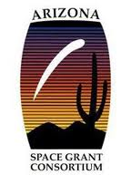
Radioactive Carbon-14 Dating of Meteorites and Lunar Materials
Caitlin Schnitzer
Mentor: Timothy Jull, Ph.D. Department of Geosciences

Slide 2
Objective
Accurately determine the age of samples by extracting the remaining Carbon-14
Pre-treat all samples using hydrolysis, combustion, and oxidation reduction chemical reactions
Supply a timely and accurate date to the researcher

Slide 3
Problem
What is the best way to extract carbon from a sample?
After extraction, how accurate is the dating process?

Slide 4
Solutions
Usage of a vacuum sealed, glass line
Carrying out two pivotal chemical reactions
Hydrolysis and combustion
Comparison of data to estimated impact
Only available for “known” falls

Slide 5
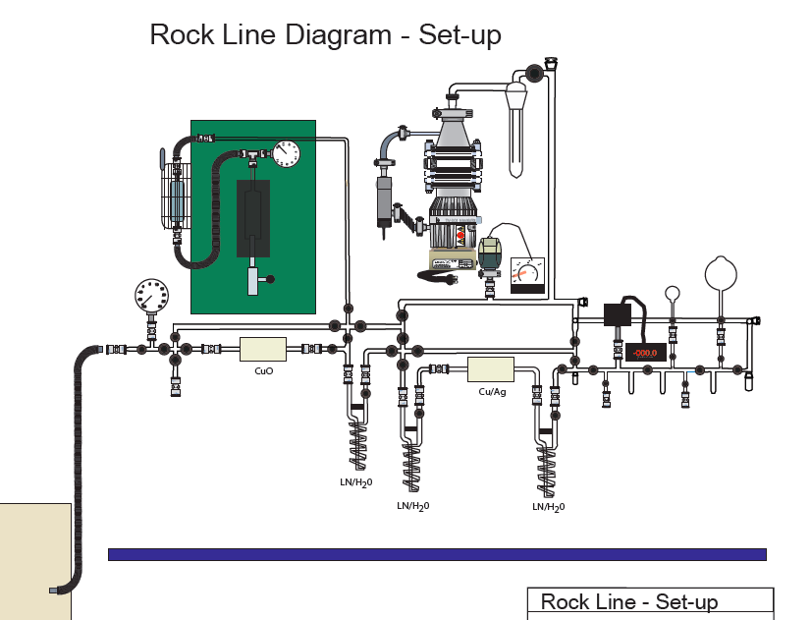
Photo of Line

Slide 6
Determination of Age
Age determined by an accelerator mass spectrometer
Ion beam sputtering to produce C-
C-12, C-13, and C-14
Separation by large magnet
Collection
Determination
Comparison

Slide 7
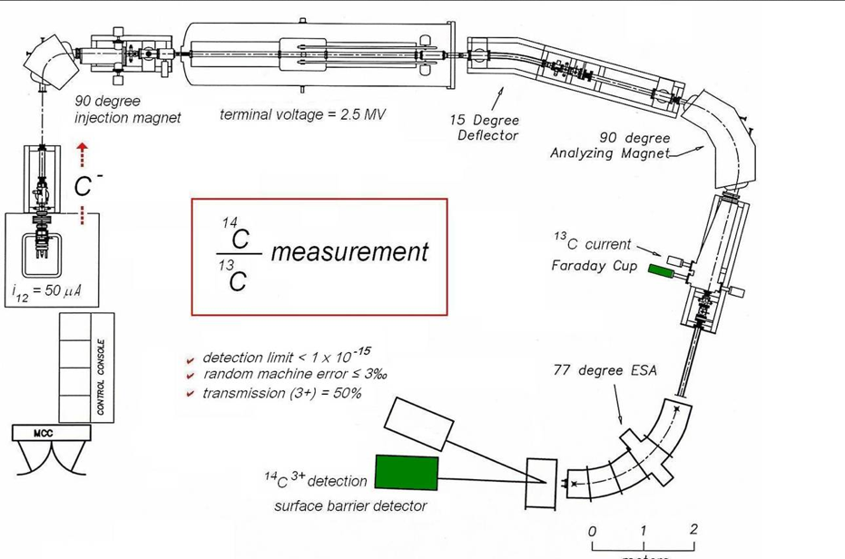

Slide 8
Comparison Values
Sites | Radioactive Carbon-14 Determined Age (Kyr) | Estimated, “known” (yr)
Canyon Diablo | 10.9 | 50,000
Odessa, TX | 6.6 | 63,000
Campo del Cielo | 21.0 | N/A
Sikhote-Alin | 11.0 | 65
Gibeon 201 | 24.3 | N/A
Gibeon Z4.7 | 15.4 | N/A
Imilac | 17.2 | N/A
Courtesy of Dr. Tim Jull

Slide 9
Analysis
The three with “known” dates differ from experimental dates.
“Known” dates for Canyon Diablo and Odessa, TX are beyond the scope of radioactive dating (>50,000 yrs)
Estimated “known” dates could be incorrect

Slide 10
Discrepancies in Dating
Discrepancies do arise in Carbon-14 dating
Can occur due to samples being:
Too old
Too small
Non-uniform carbon (i.e. Iron meteorites)

Slide 11
Accounting for discrepancies
Larger sample size during pre-treatment
Re-Run sample
Research is currently being conducted to determine how to accurately date pure iron meteorites.

Slide 12
Conclusions
Accurate dates on pure iron meteorites are difficult to obtain.
Previous estimated fall data may be incorrect
More research should be conducted on iron meteorites.

Slide 13
Special Thanks
National Science Foundation-Accelerated Mass Spectrometry Lab (NSF-AMS)
Timothy Jull, Ph.D, Department of Geosciences
Alexander Leonard, Research Scientist NSF-AMS
The NASA Space Grant Consortium

